Slide 1
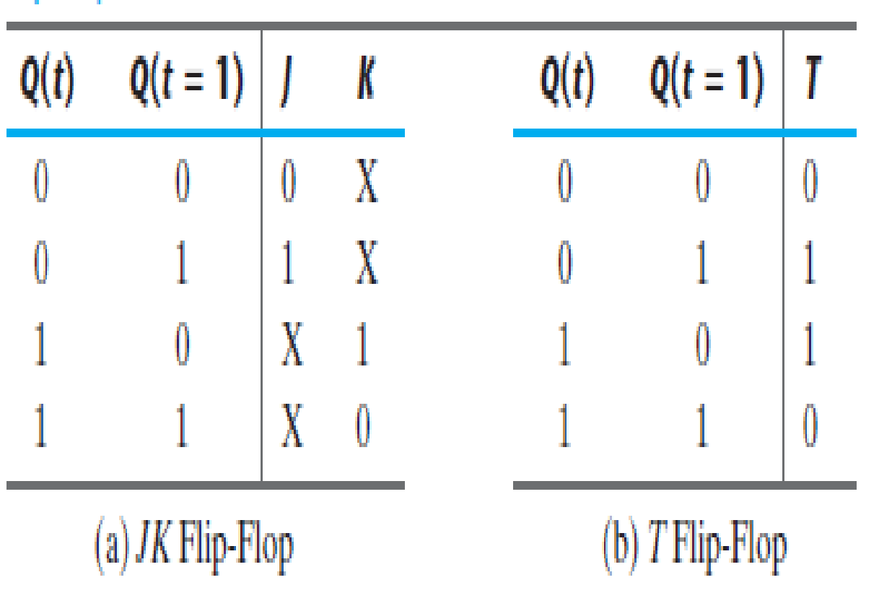
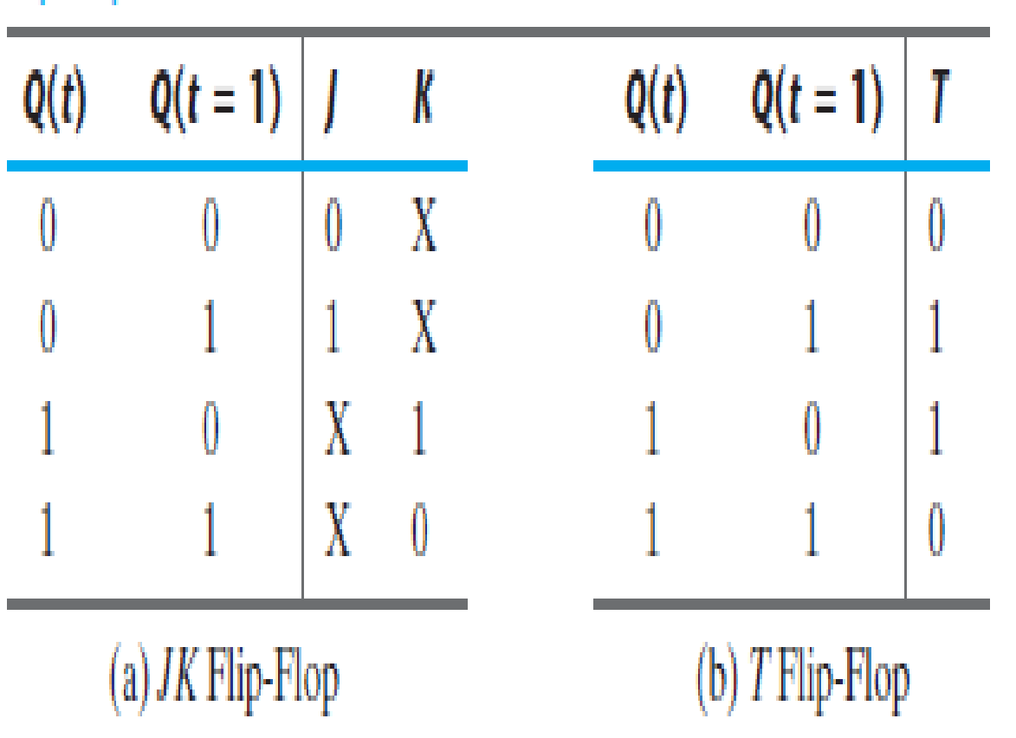
Excitation Tables
J | K | Qt+1
0 | 0 | Qt
0 | 1 | 0
1 | 0 | 1
1 | 1 | Qt’
T | Qt+1
0 | Qt
1 | Qt’

Slide 2
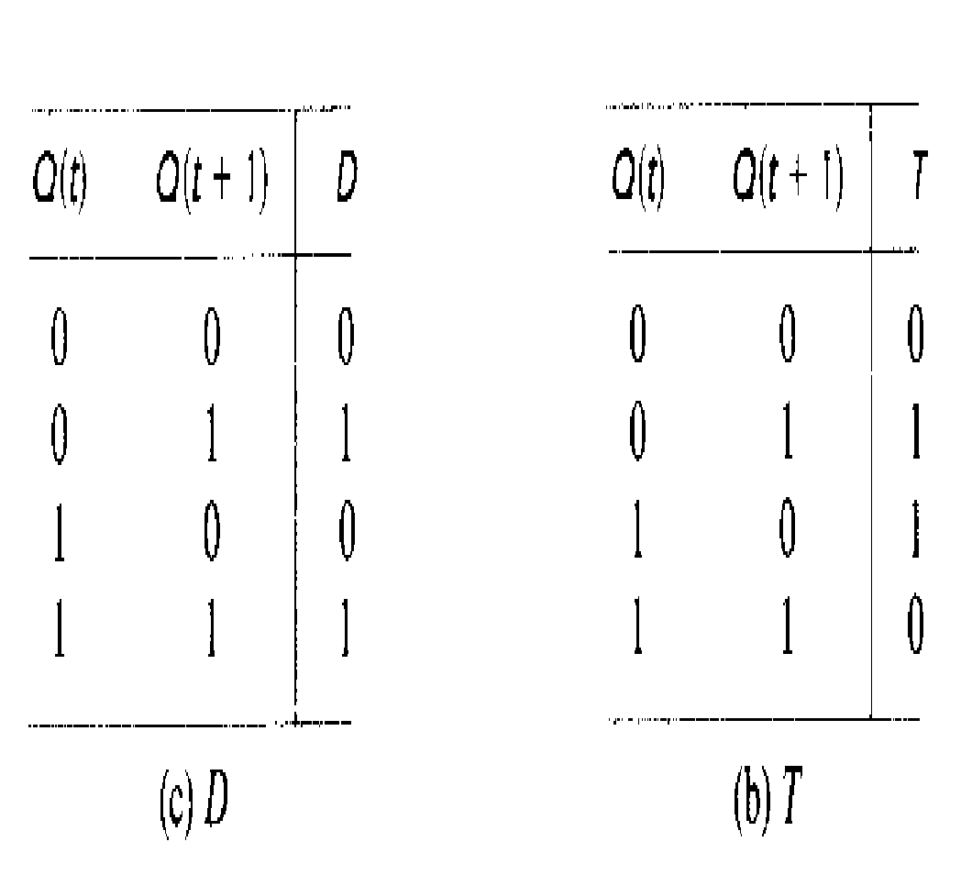
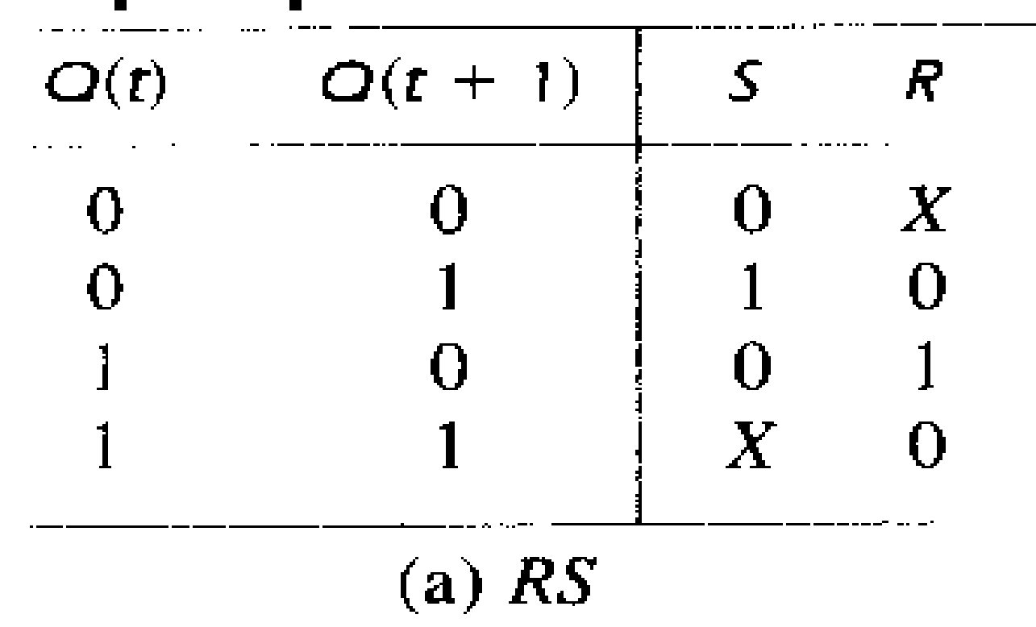
D | Qt+1
0 | 0
1 | 1
S | R | Qt+1
0 | 0 | Qt
0 | 1 | 0
1 | 0 | 1
1 | 1 | ?
(d) SR FF

Slide 3
DESIGN PROCEDURE
The problem may be given by the word description or state diagram or state table
From the given information obtain the state table
Reduce the number of states if necessary.
Assign binary values to the states.
Determine the number of FFs needed and assign a letter symbol to each
Choose the type of flip-flops to be used.
Derive the circuit excitation and output tables
Derive the simplified flip-flop input equations and output equations.
Draw the logic diagram.

Slide 4
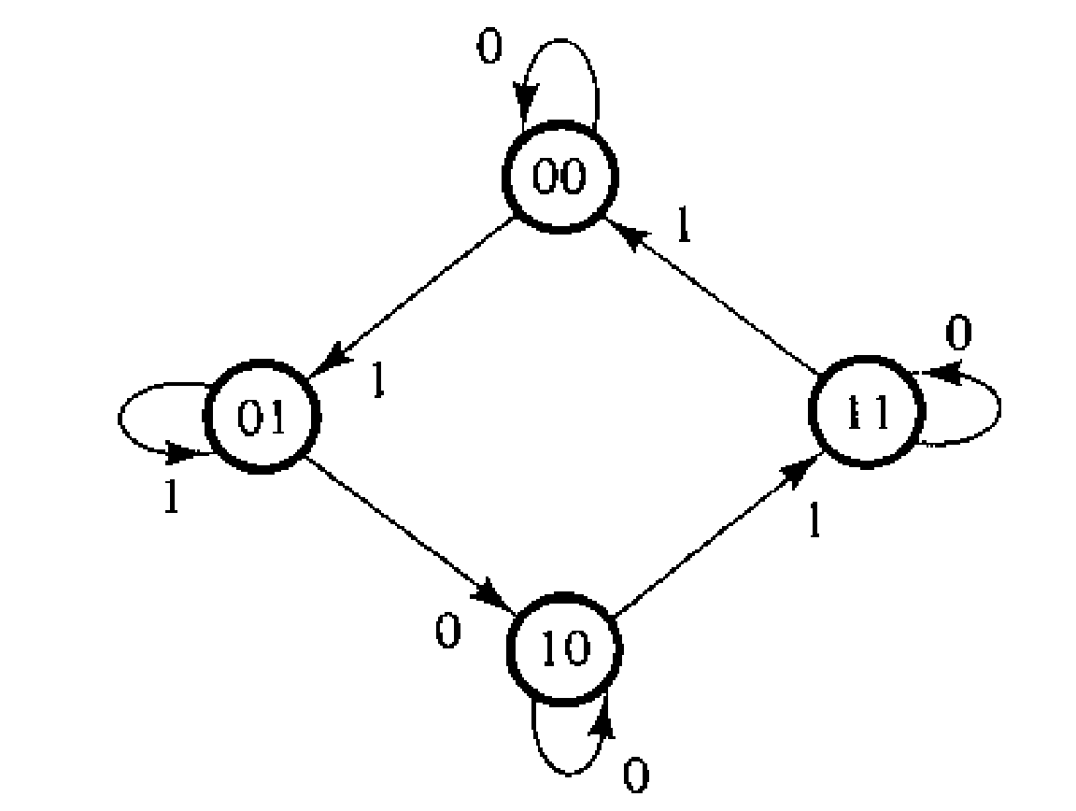
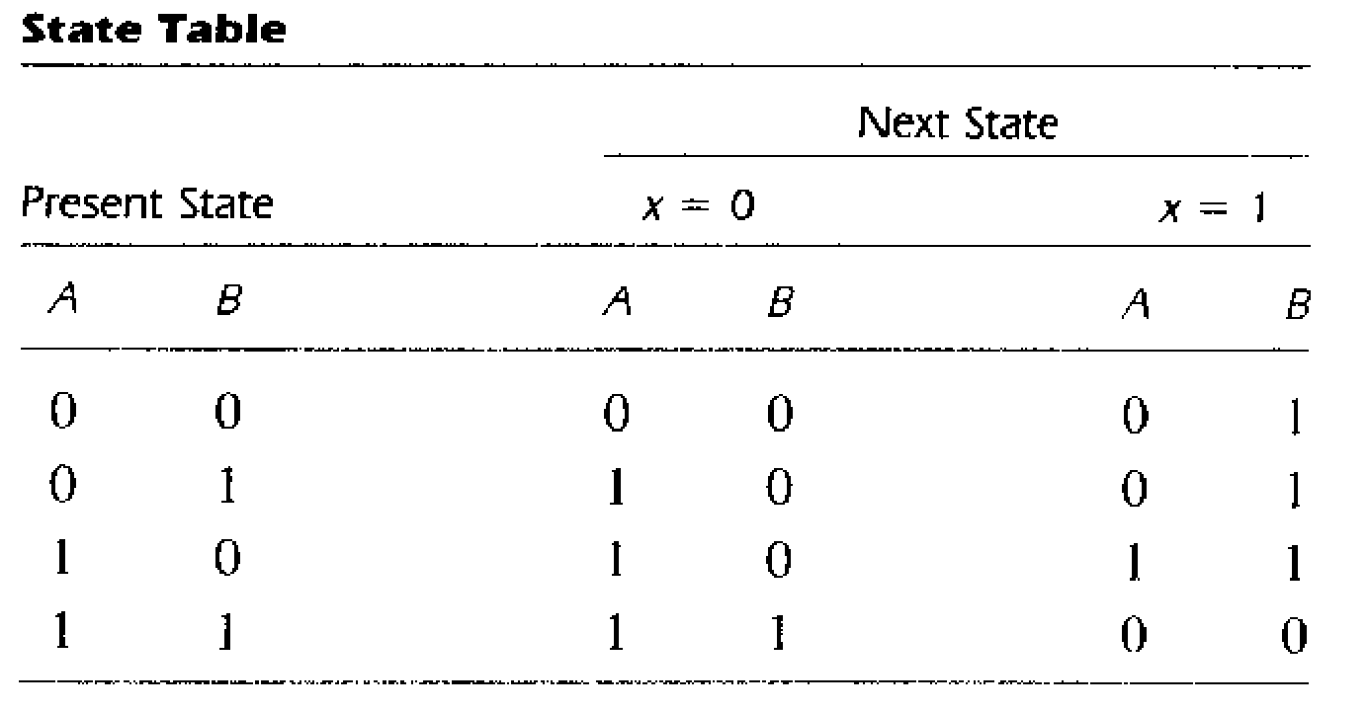
Example 1: Design the synchronous sequential circuit for the following state diagram using JK FF
Solution:

Slide 5
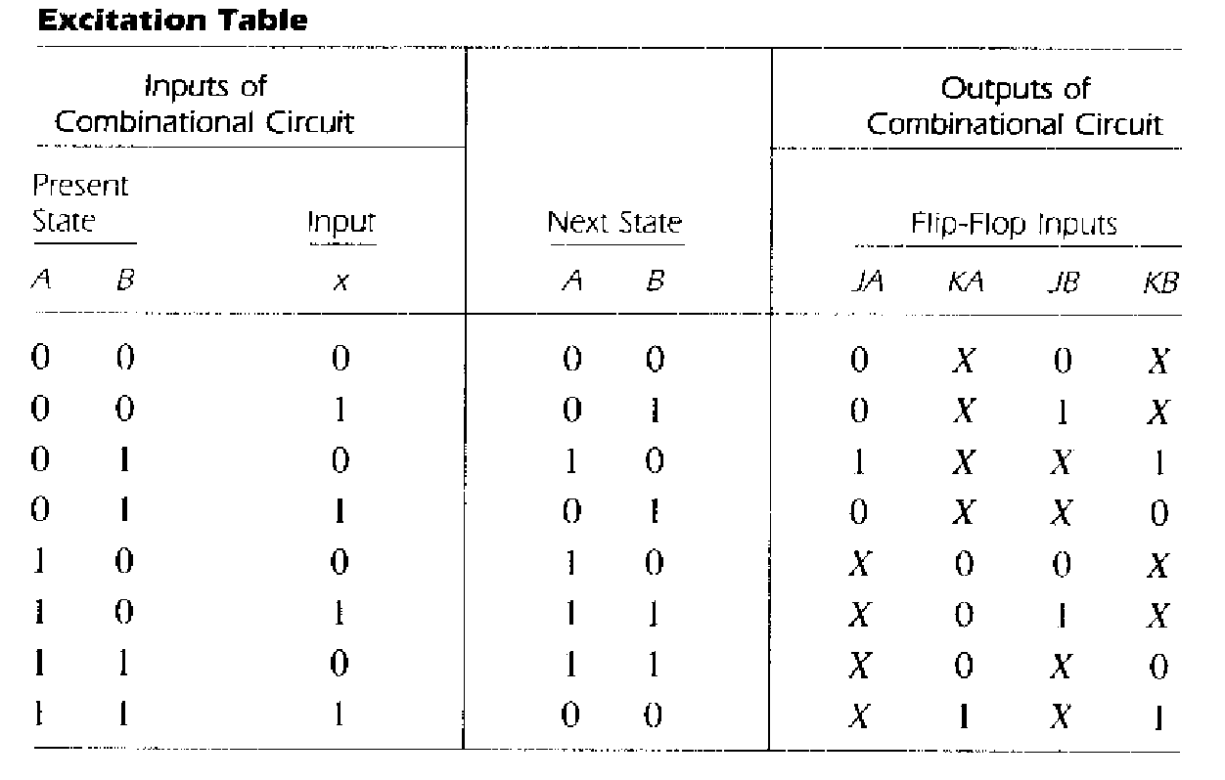

Slide 6
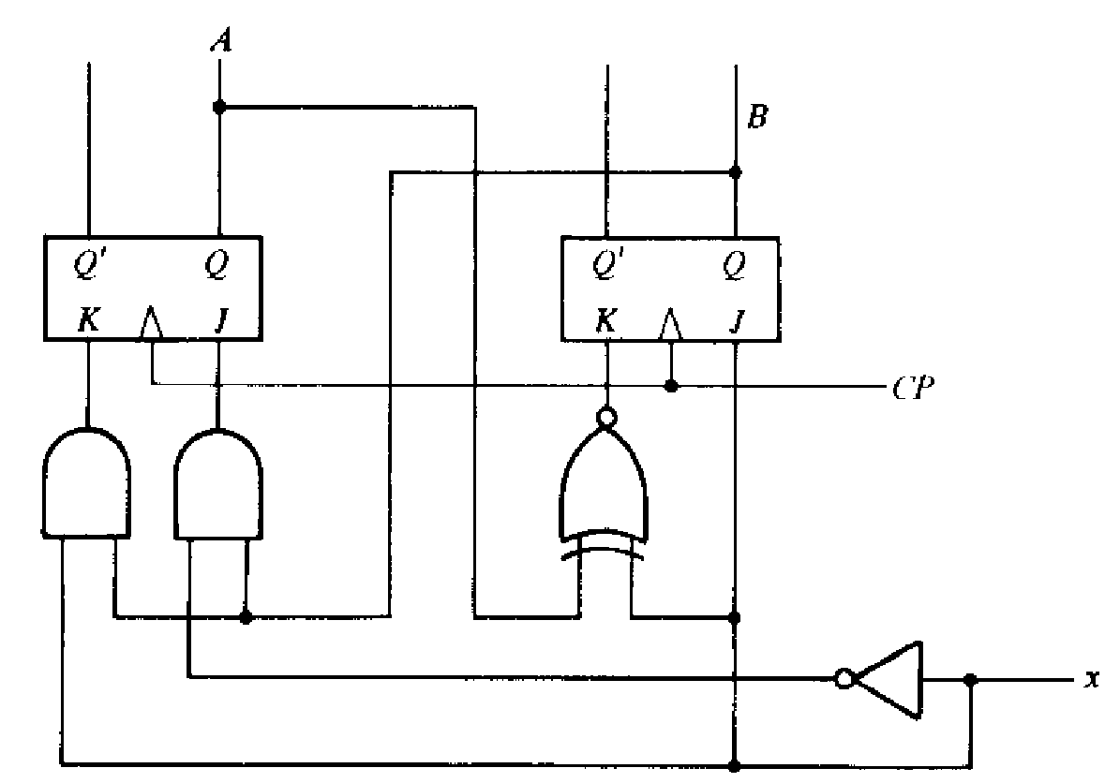

Slide 7
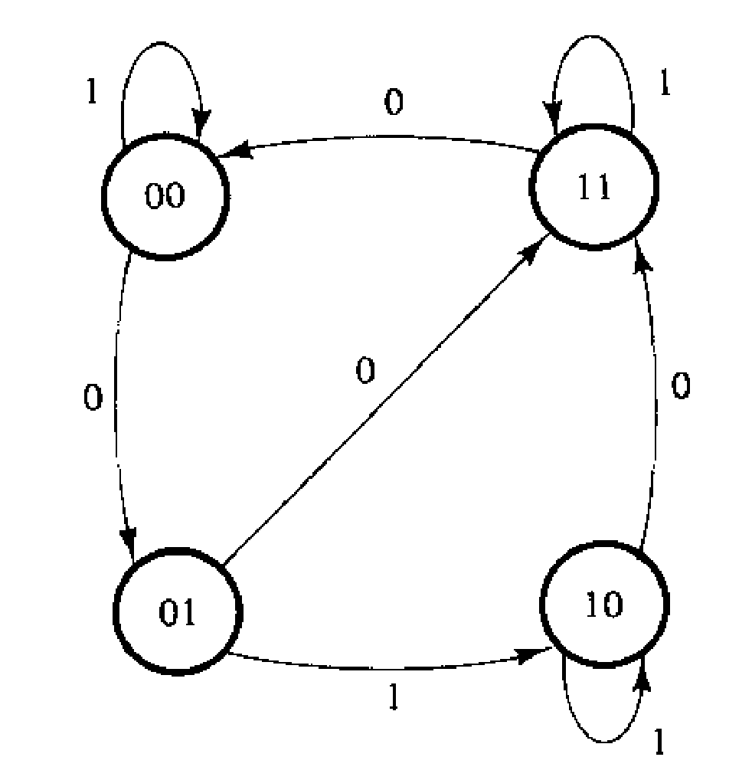
Example 2: Design the synchronous sequential circuit for the following state diagram using T FF-(Exercise for the students to solve)
Solution:
Ta = A’B +Bx’
Tb = B’x’ + Ax’ + A’Bx

Slide 8
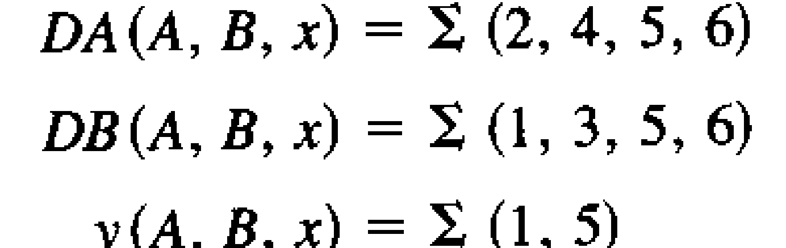
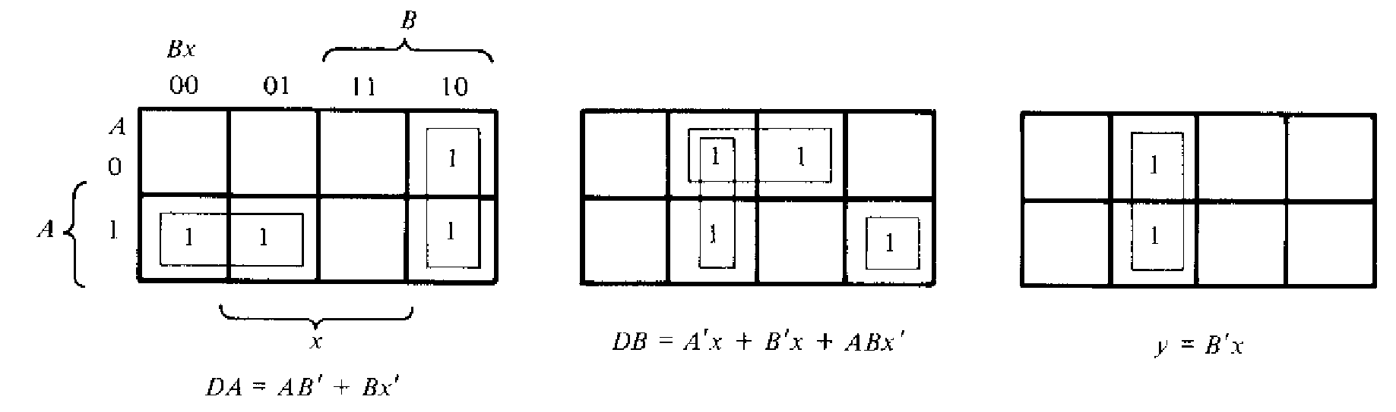
Design with D FFs
Design if
A(t+1)=
B(t+1)=
Solution:

Slide 9
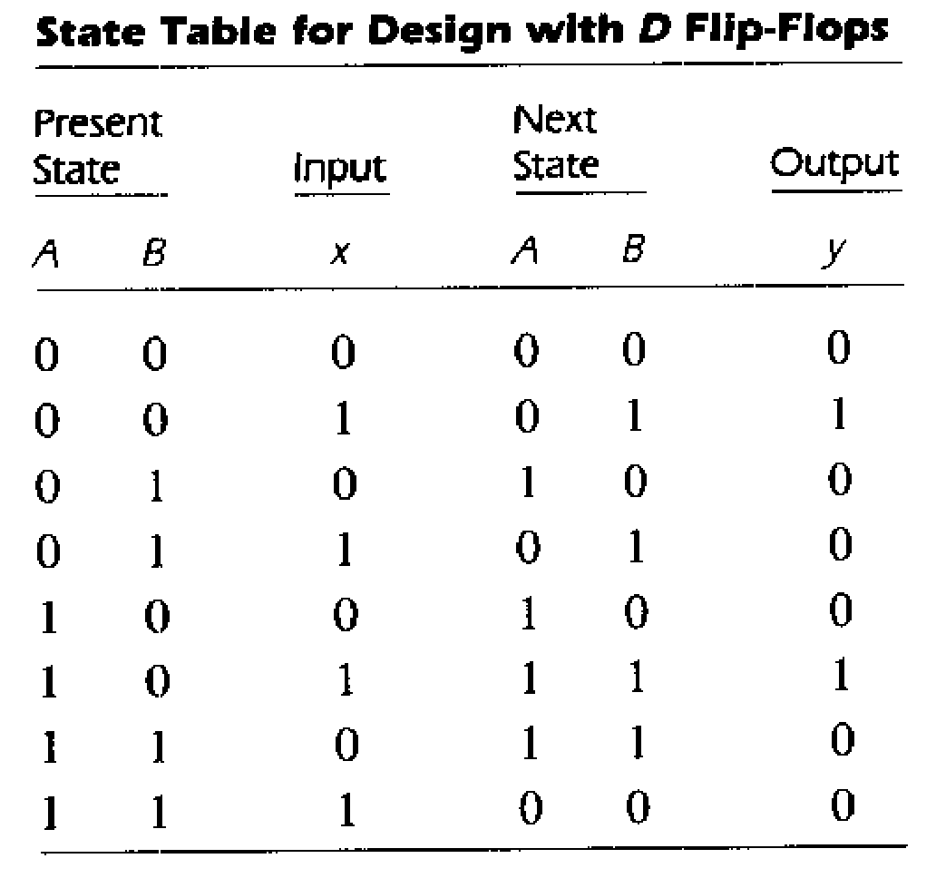

Slide 10
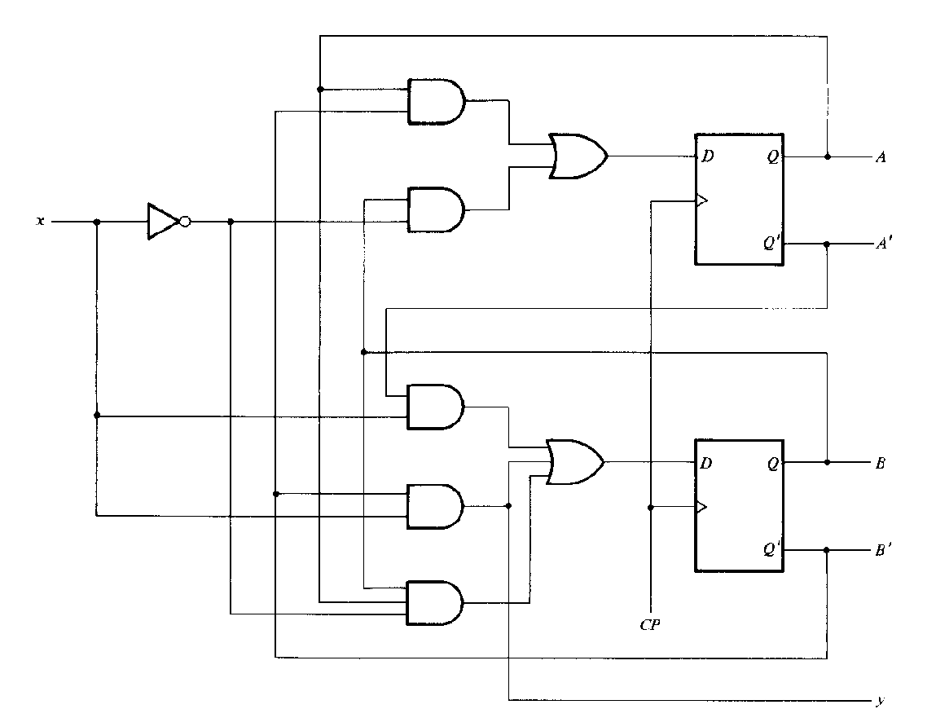

Slide 11
State Reduction
The reduction in the number of flip-flops in a sequential circuit is referred to as the state-reduction problem.
Since m flip-flops produce 2^{m} states, a reduction in the number of states may (or may not) result in a reduction in the number of flip-flops.
An unpredictable effect in reducing the number of flip-flops is that sometimes the equivalent circuit (with fewer flip-flops) may require more combinational gates to realize its next state and output logic.

Slide 12
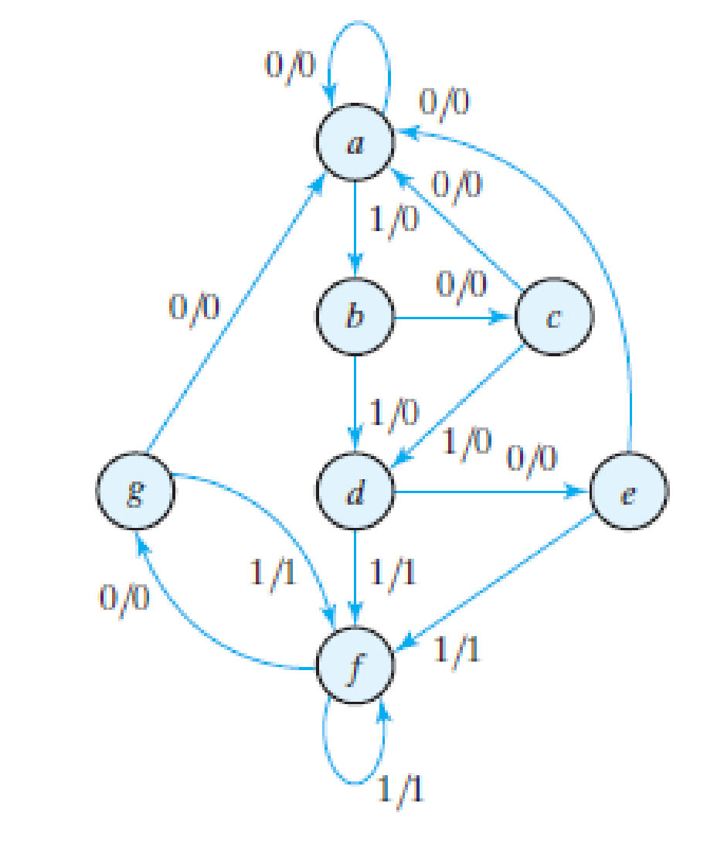
Example:
There are an infinite number of input sequences that may be applied to the circuit; each results in a unique output sequence. As an example, consider the input sequence 01010110100 starting from the initial state a. Each input of 0 or 1 produces an output of 0 or 1 and causes the circuit to go to the next state.

Slide 13
State a a b c d e f f g f g a
Input 0 1 0 1 0 1 1 0 1 0 0
Output 0 0 0 0 0 1 1 0 1 0 0
In each column, we have the present state, input value, and output value. The next state is written on top of the next column.

Slide 14
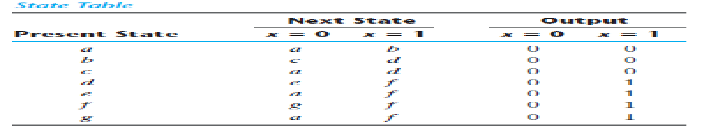

Slide 15


Slide 16
The following algorithm for the state reduction of a completely specified state table is used: “Two states are said to be equivalent if, for each member of the set of inputs, they give exactly the same output and send the circuit either to the same state or to an equivalent state.” When two states are equivalent, one of them can be removed without altering the input–output relationships.

Slide 17
we look for two present states that go to the same next state and have the same output for both input combinations. States e and g are two such states: They both go to states a and f and have outputs of 0 and 1 for x = 0 and x = 1, respectively. Therefore, states g and e are equivalent, and one of these states can be removed.

Slide 18
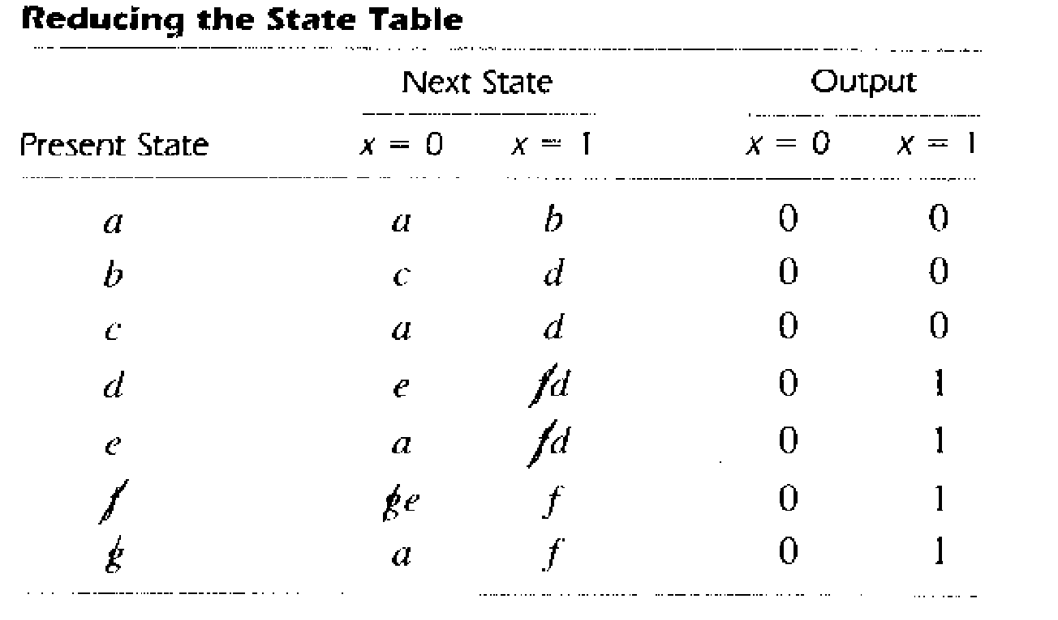

Slide 19
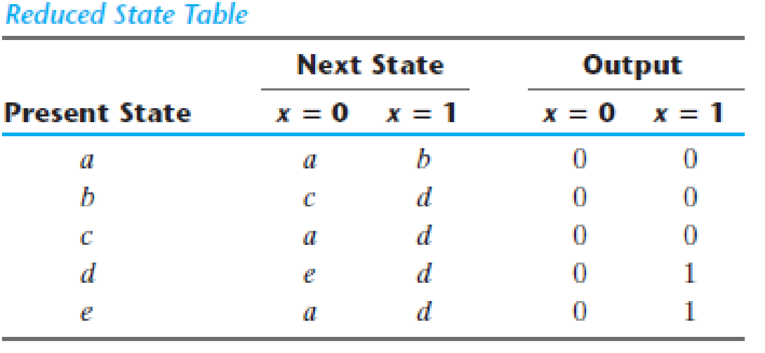
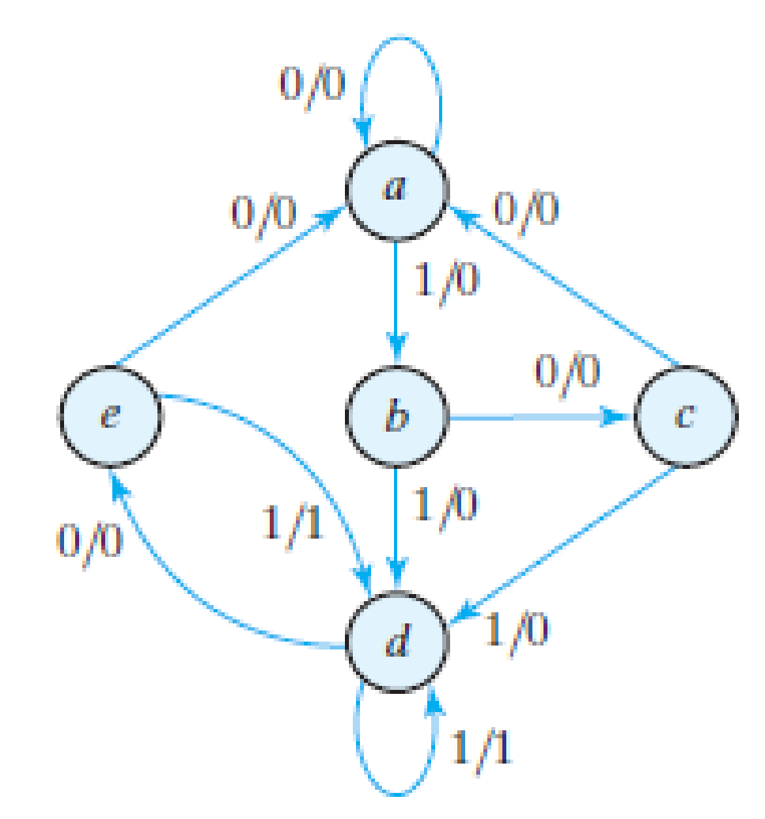
State a a b c d e d d e d e a
Input 0 1 0 1 0 1 1 0 1 0 0
Output 0 0 0 0 0 1 1 0 1 0 0

Slide 20
The sequential circuit of this example was reduced from seven to five states but the no. of FFs are not reduced because 5 states require 3 FFs that is same for 7 states too. In general, reducing the number of states in a state table may result in a circuit with less equipment because the unused states are taken as don’t cares in the design process. However, the fact that a state table has been reduced to fewer states does not guarantee a saving in the number of flip-flops or the number of gates.

Slide 21
State Assignment
In order to design a sequential circuit with physical components, it is necessary to assign unique coded binary values to the states. For a circuit with m states, the codes must contain n bits, where 2^{n} ≥ m. For example, with three bits, it is possible to assign codes to eight states, denoted by binary numbers 000 through 111. For 5 states, we are left with three unused states. Unused states are treated as don’t-care conditions during the design. Since don’t-care conditions usually help in obtaining a simpler circuit, it is more likely but not certain that the circuit with five states will require fewer combinational gates than the one with seven states.

Slide 22
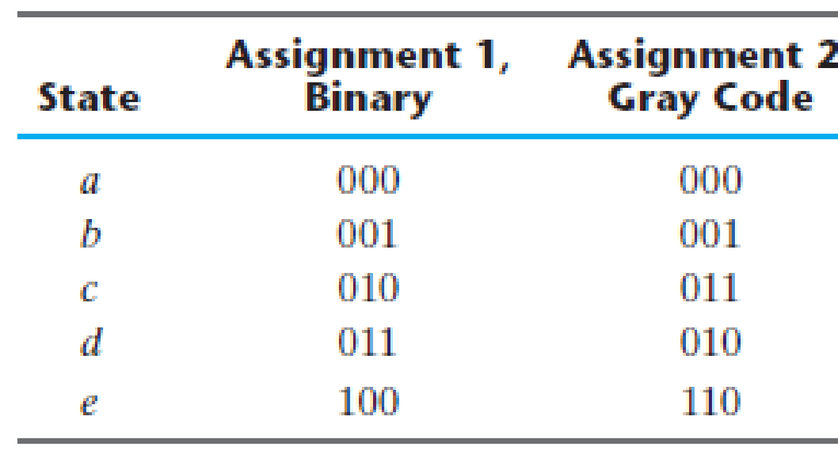
The simplest way to code five states is to use the first five integers in binary counting order. Another similar assignment is the Gray code. Here, only one bit in the code group changes when going from one number to the next. This code makes it easier for the Boolean functions to be placed in the map for simplification. There are many possibilities.

Slide 23
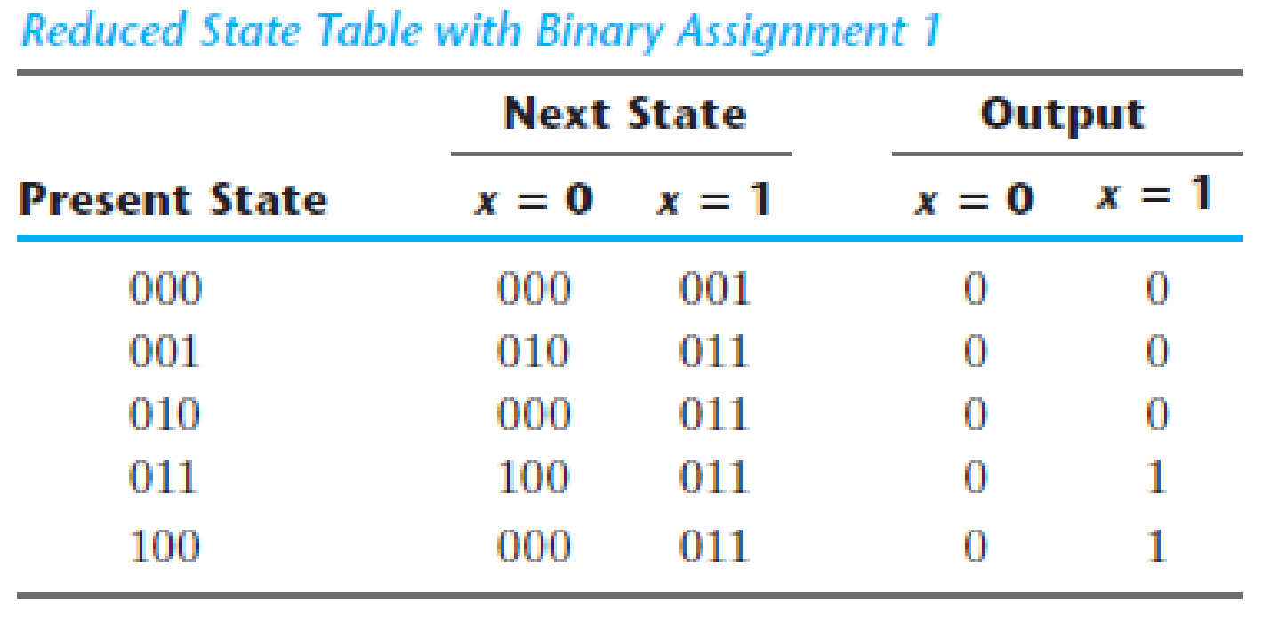

Slide 24

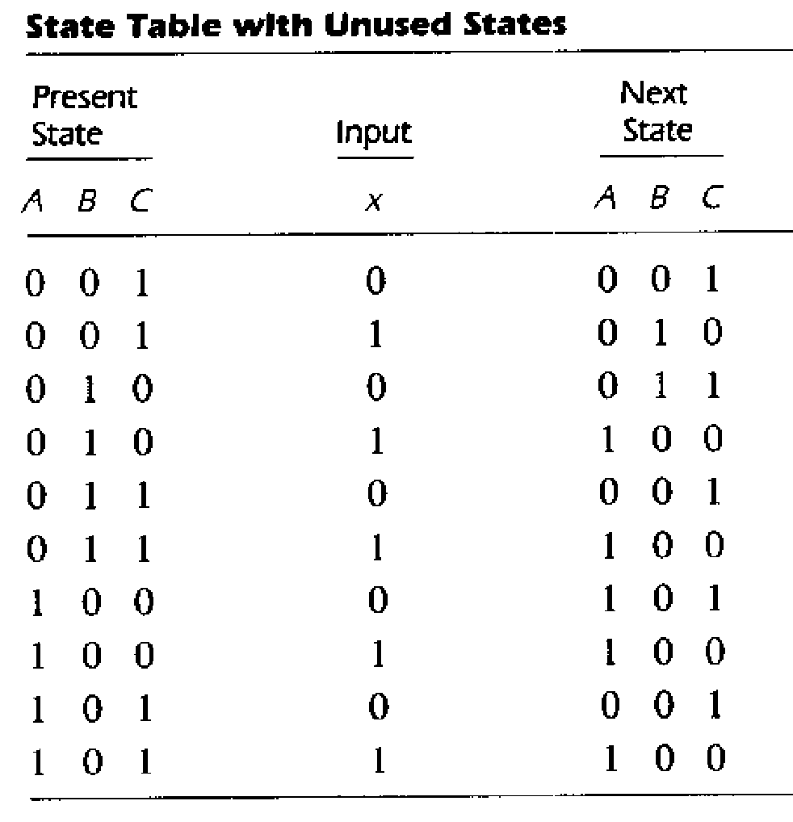
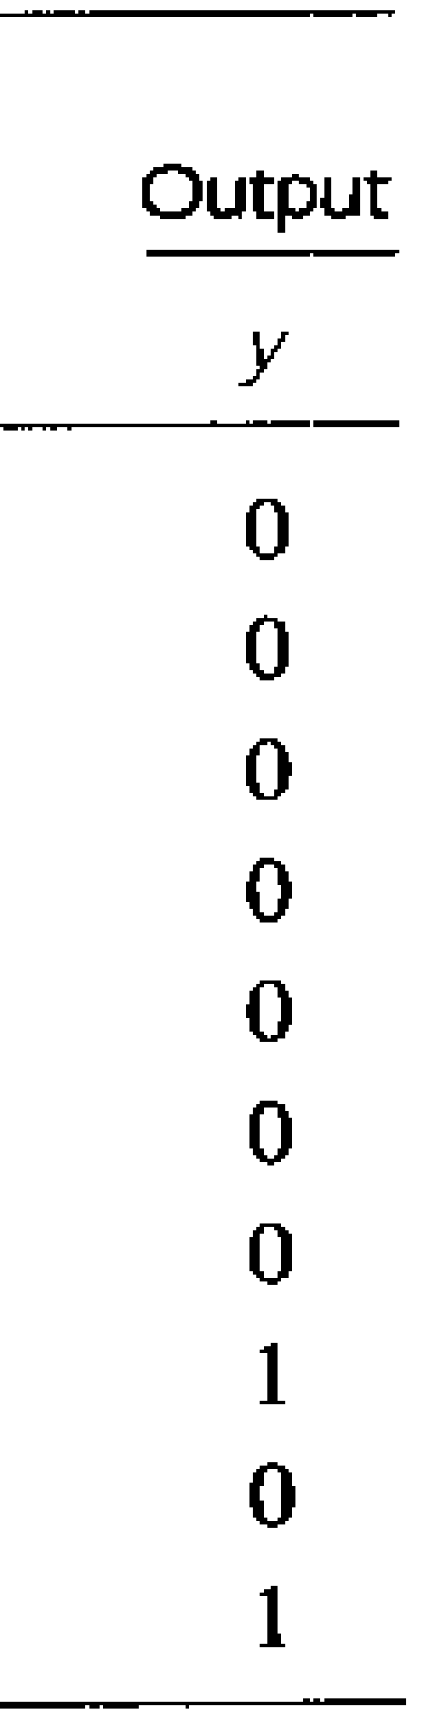
Design the synchronous sequential circuit for the following state table:

Slide 25
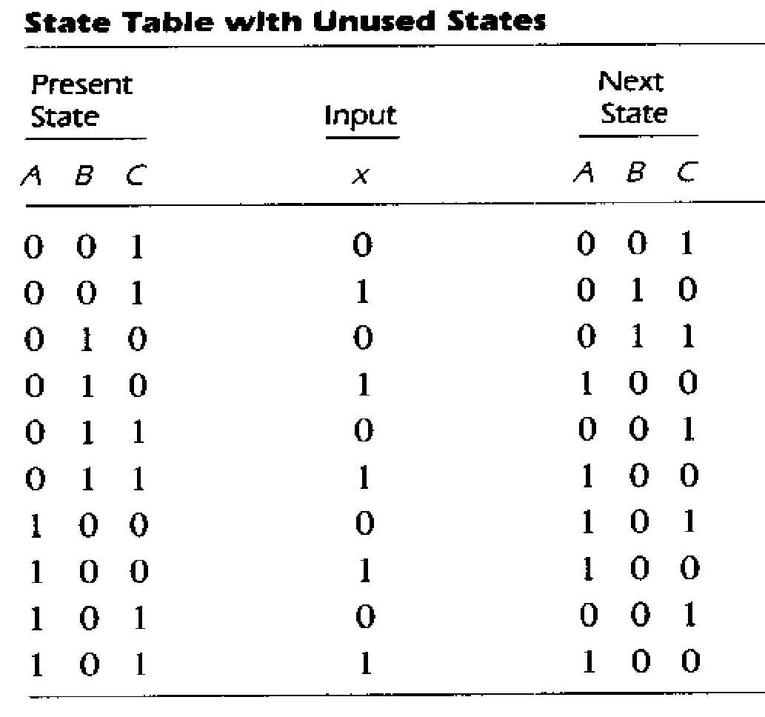
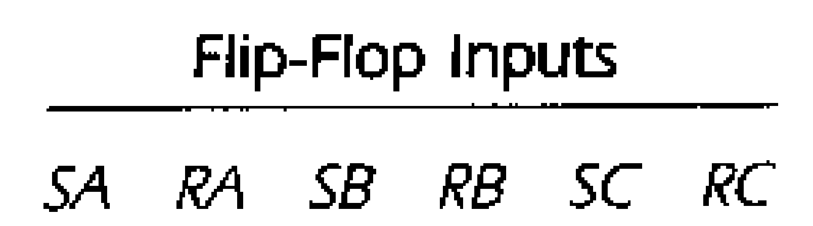
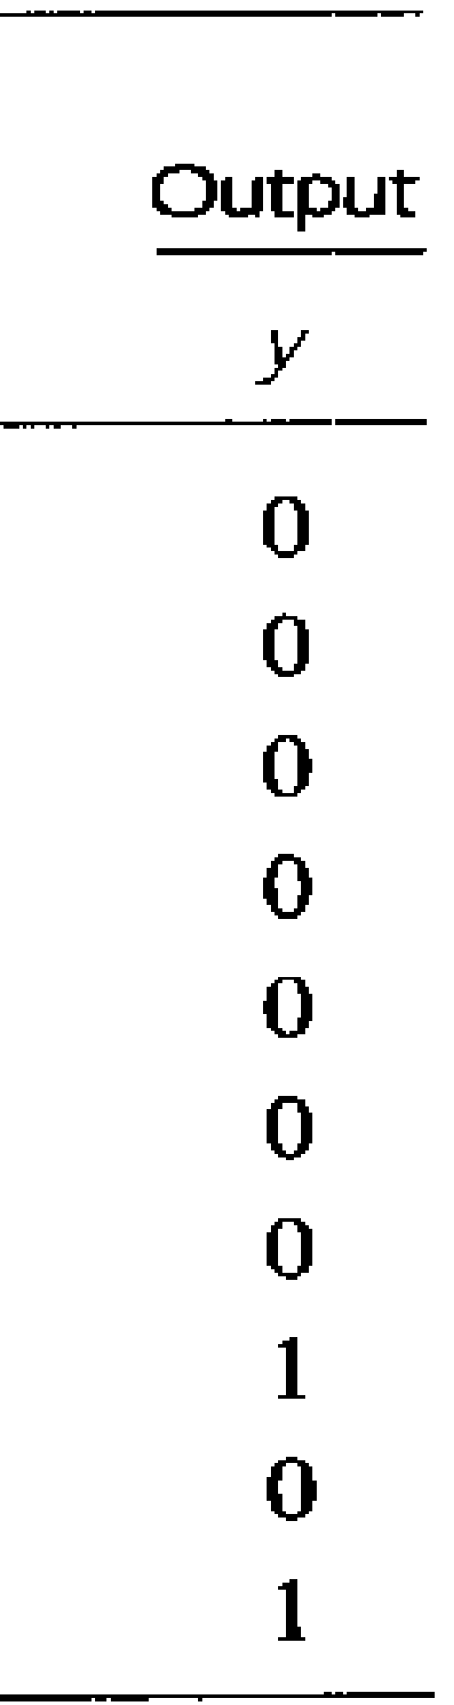

Slide 26
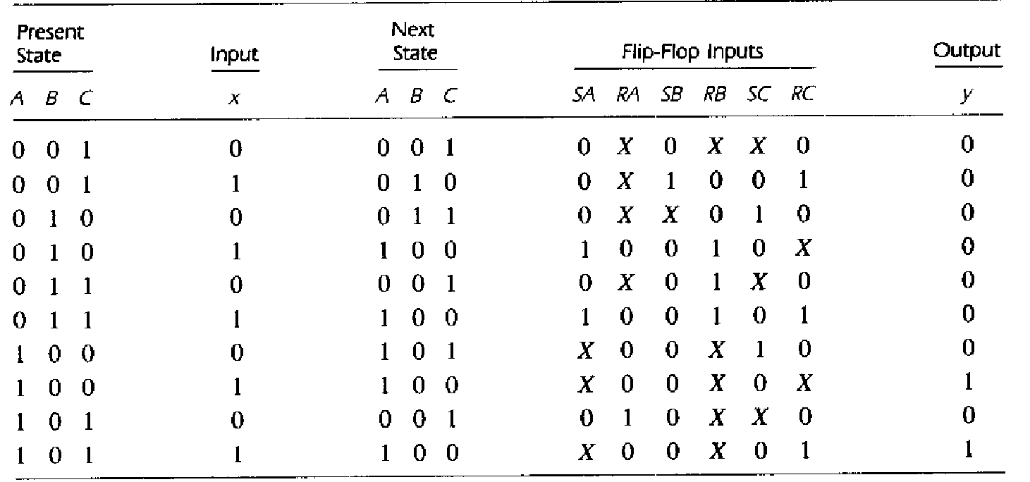

Slide 27
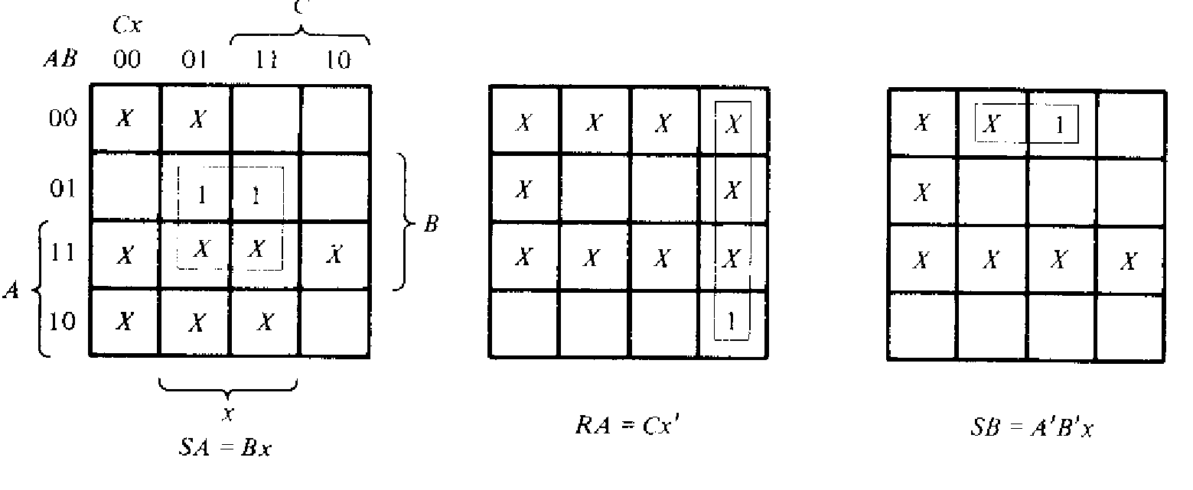
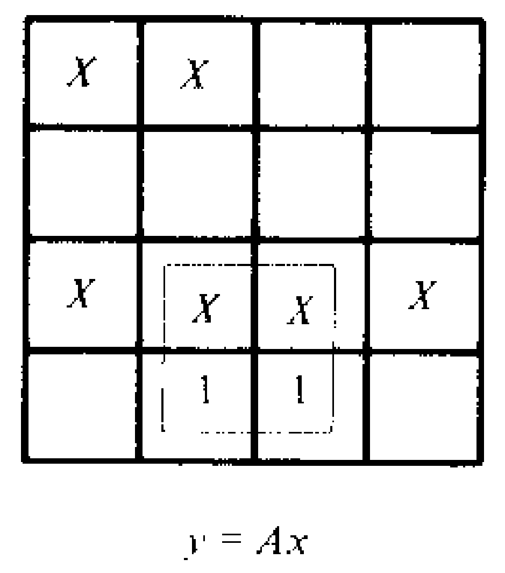
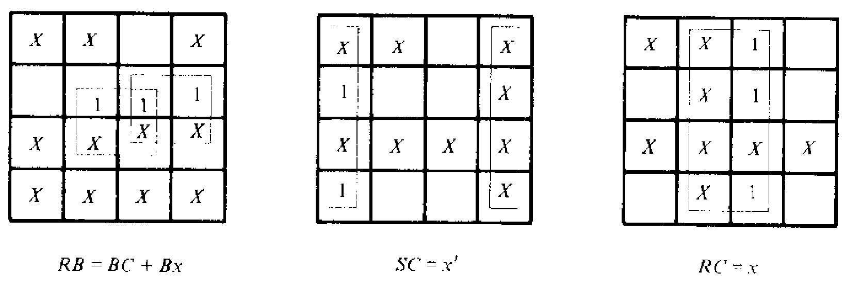

Slide 28
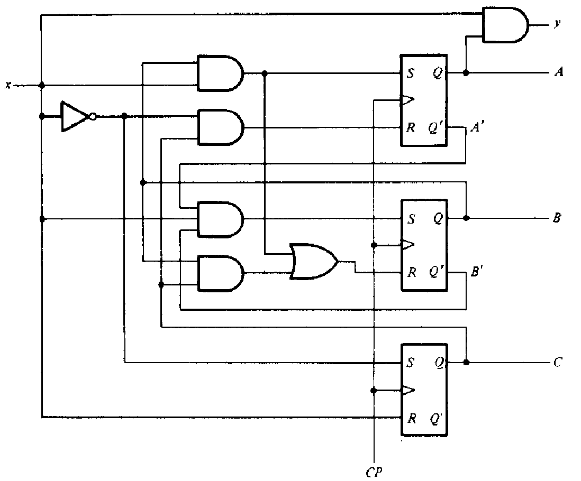

Slide 29
Example: Design a sequential circuit with two JK flip-flops A and B and two inputs E and F . If E = 0, the circuit remains in the same state regardless of the value of F . When E = 1 and F = 1, the circuit goes through the state transitions from 00 to 01, to 10, to 11, back to 00, and repeats.
When E = 1 and F = 0, the circuit goes through the state transitions from 00 to 11, to 10, to 01, back to 00, and repeats
Solution:
JA = KA = (B’F’ + BF)E
JB = KB = E

Slide 30
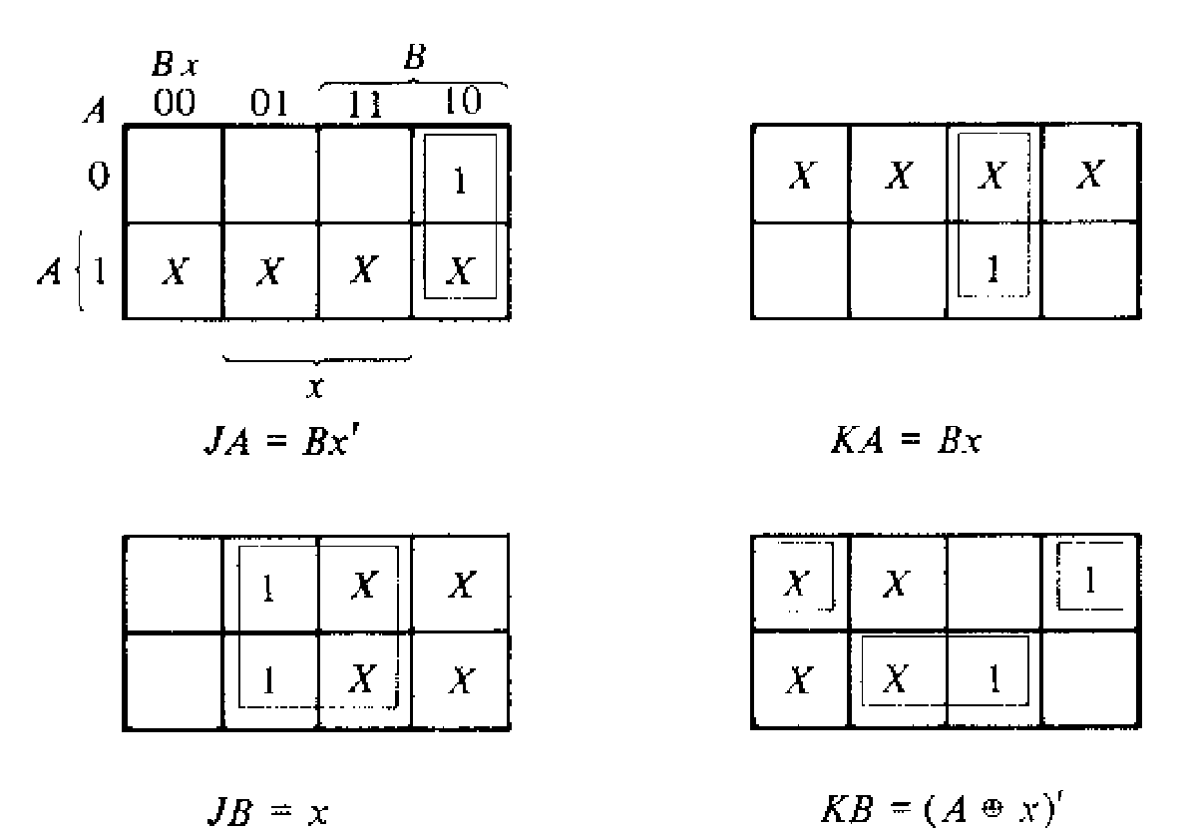

Slide 31
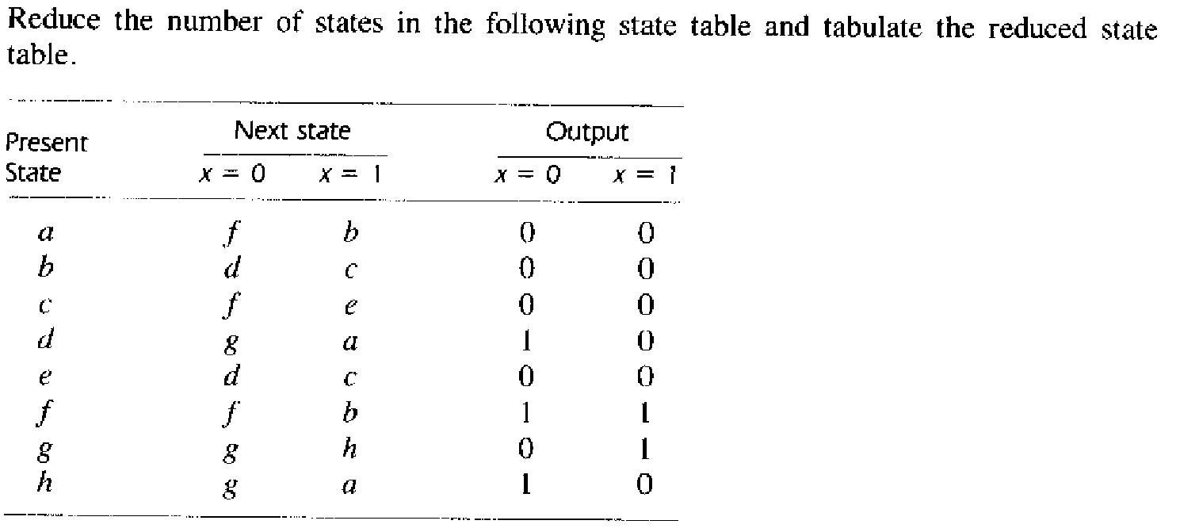
Home work:
1.

Slide 32
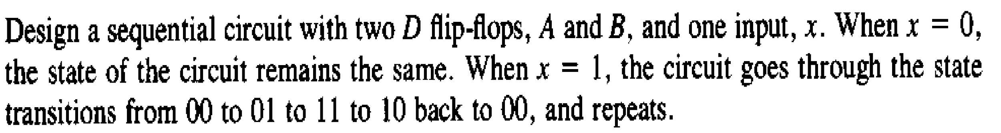
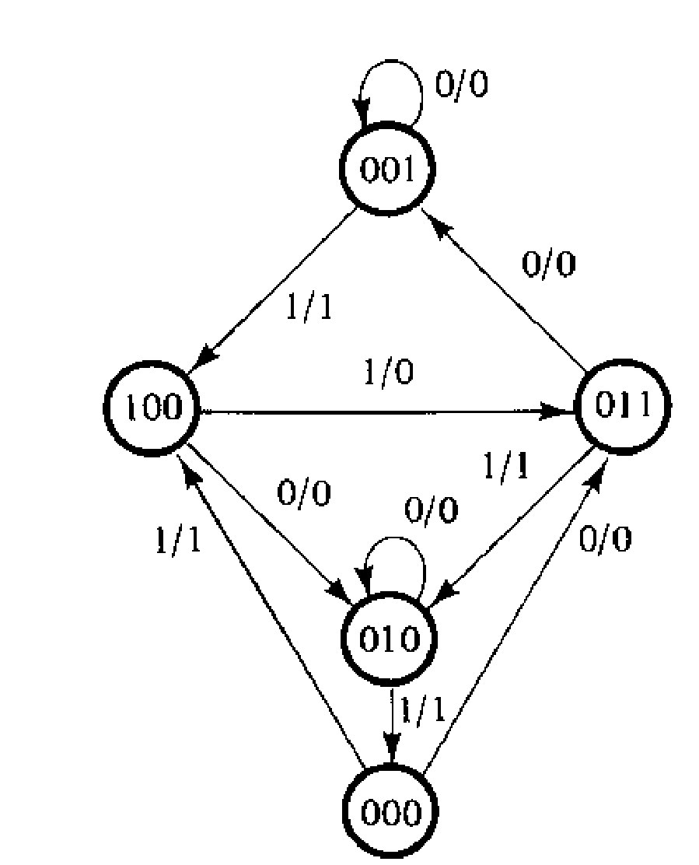

2
3. Design the sequential circuit for the following state diagram

